Slide 1
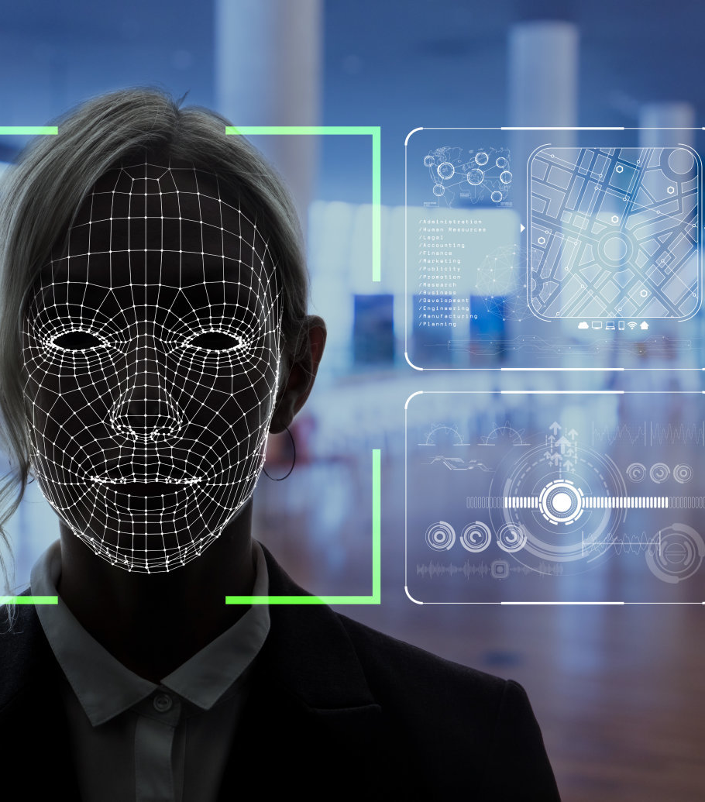
Robotic personal assistant (RPA) for corporate visitor management system
Student Name: Hatem Hussein WEA140701
Supervisor Name:
Dr. Zati Hakim Azizul Hasan

Slide 2
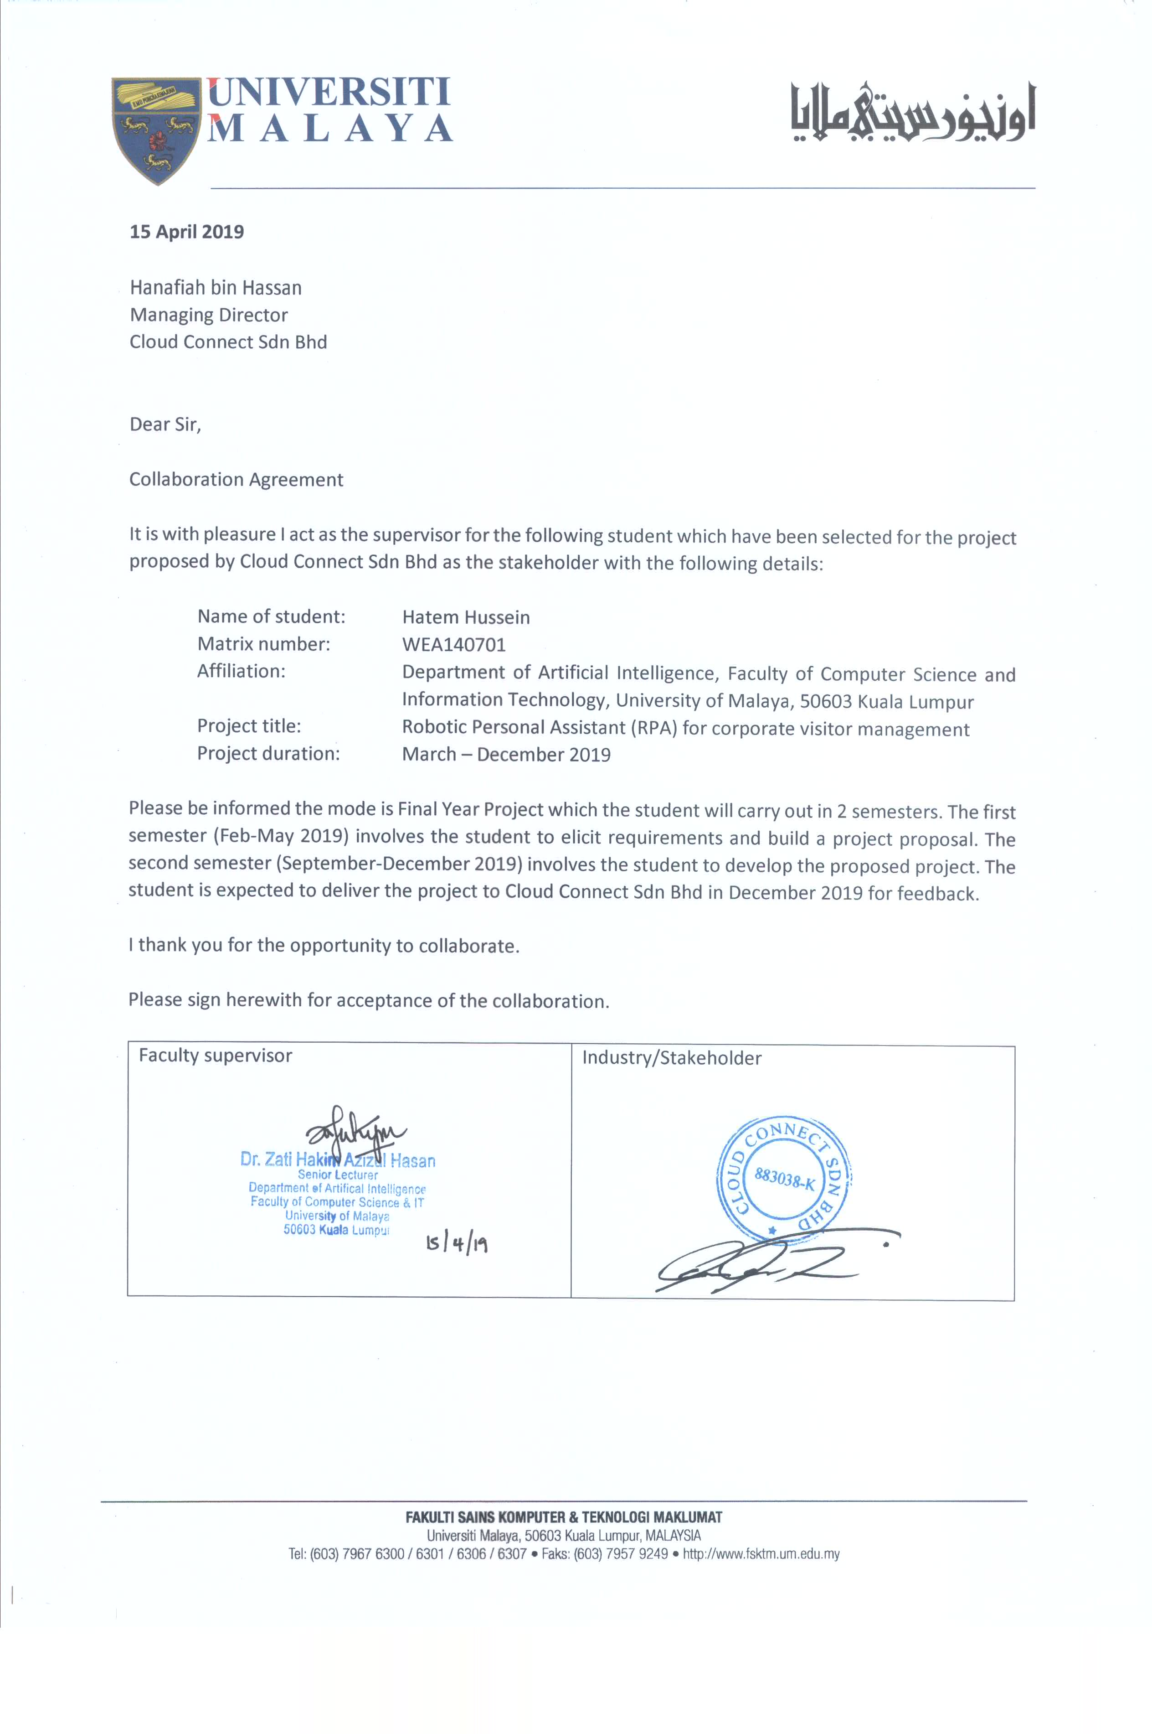
Stakeholder: “Cloud Connect Sdn Bhd”

Slide 3
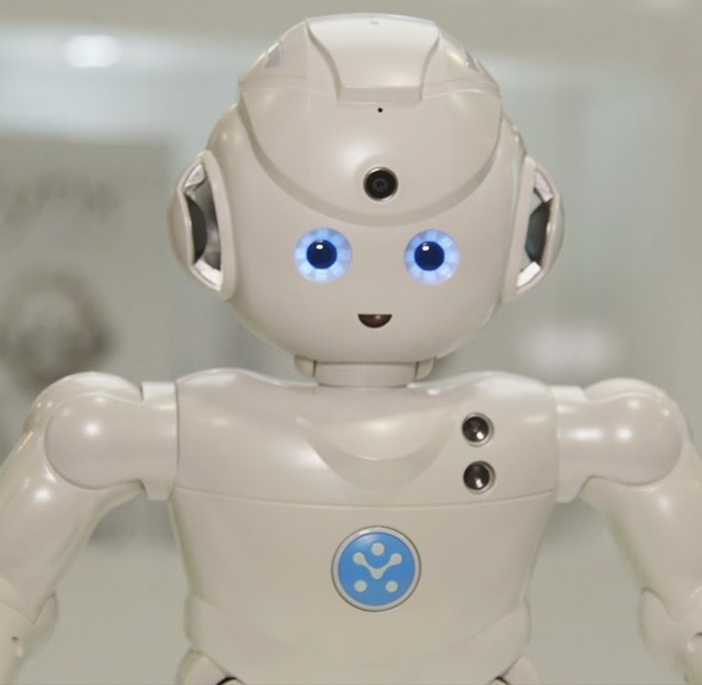
Background & Motivation
RPA stands for Robotic Personal Assistant. RPA is an intelligent system whereby intelligent applications are developed and installed into humanoid robot.
RPA is widely popular to help human personal assistant (HPA) such as the receptionist to automate routine tasks and improve data collection process
RPA is yet to be commercially available in corporate sector in Malaysia.
One application that is in demand is automated corporate visitor management system. The versatility of the RPA extends the application for daily visitor at the organization, and also at special event/functions.
To improve first impression, robotic personal assistant is a great way of enhancing the corporate a brand image.

Slide 4

Traditional corporate visitor management in Malaysia
Use of guest book (pen and paper approach) to record details of visitor, purpose of visit and timestamp.
Guest book does not record photo of visitor.
Require a person (usually receptionist) to facilitate the process.
Guest book does not usually record complete business details of visitor. Usually require visitor to drop business card at counter.
Repeating visitor must record personal details in guest book again (inefficient).

Slide 5
Problem statement
Pen and paper approach make extracting socio-demographics (e.g. VIP status, gender, location) and monitoring of visitor (e.g. frequency of visit, reason of visit, etc) difficult.
Lack of photo to identify with the visitor can pose security at risk
Requirement of receptionist is waste of human resources for mundane task
If no business card collected, there is no full business detail by visitor
Duplicating records from guestbook entries, business cards and repeating visitor is inefficient
To improve the problems stated above, this work is interested to develop an intelligent visitor management system utilising face recognition and OCR to scan visitor faces and business cards and organized the information into a database for monitoring analysis. As an added enhancement, this work will also look at emotion detection to ensure visitor’s registered photo is aesthetically pleasant for corporate record purposes. This extension can be a stand-alone module for group photo taking at corporate functions.

Slide 6
Objectives
To develop an intelligent system that simulates the process of traditional corporate visitor management system.
To implement face recognition and OCR techniques for corporate visitor profiling.
To implement SmartShot, a live photo capture with emotion detection techniques.

Slide 7
Literature Review
Reference | Aim of work | Result | Gap
Visitor Management System (ViMS) by CALMS Technologies (2016). | Introduce pre-appointment online portal registration self registration. | Hight accuracy pre appointment system via online Portal. | Requires human assistant, and no Ai technique involved. No SmartShot, No Business Card Reader.
Sanbot(2018). | Introduce a robot management system using Ai. | Work 24/7, always accessible and high standards. | High costing robot system. No SmartShot, No Business Card Reader.
iLobby Visitor Management System (2016). | Interduce interactive visitor management system. | High security, revolutionized lobby experience, and generate and print out budgets for every visitor. | Visitors data not saved, no Ai technique involved. No SmartShot, No Business Card Reader.
Mitra by Invento robotic (2018) | Introduce packs a range of AI features that would enable your customer interactions to be contextual and data centric. | High accuracy face recognition and autonomous navigation. | Only available for rent. No SmartShot, No Business Card Reader.

Slide 8
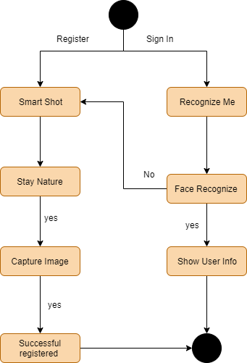
Overall System Architecture correct
Register each new visitor by:
Capture a photo and type information
or scanning Business Card and input the visitor’s
information into the system

Slide 9

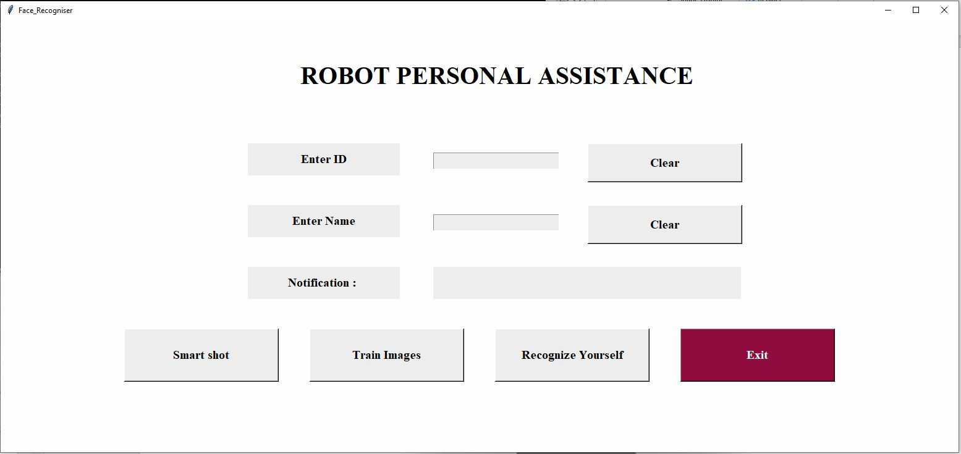
UI1: RPA for corporate visitor management system

Slide 10
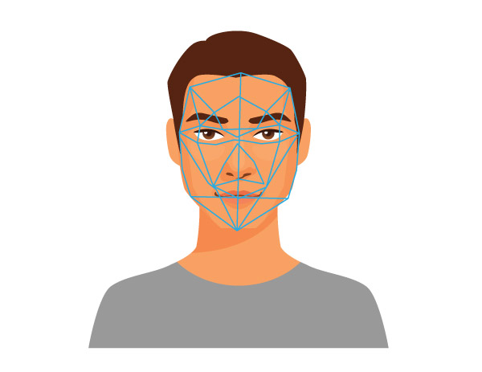
AI Technique: Face Recognition
Capturing
Capture the image of the visitor with camera
Extracting
Extract the unique facial data
Comparing
Compare the data with the database
Matching
The software then decides the sample matches any picture in the data or not

Slide 11
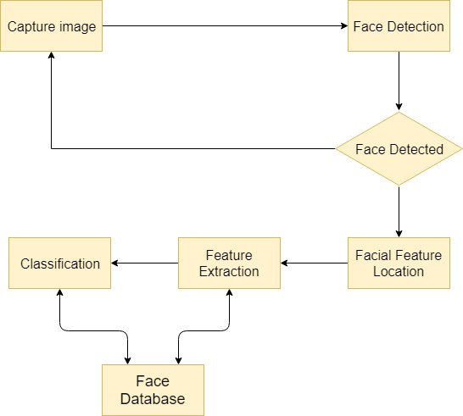
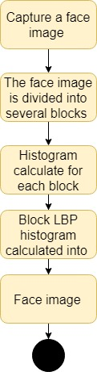
Face Recognition
Aim to Use Using LBP:
LBP is defined as an orders set of binary comparisons of pixels intensities between the center pixels and its eight surrounding pixels.
-facial recognition enables it to remember all the
Visitors, when the visitor comes again, the system can recognize
The visitor, call his/her name and preform speech communication activity

Slide 12
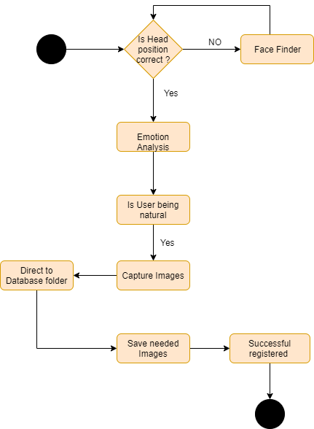
SmartShot
Features:
Head Position.
Capture Live Photo.
it can take the photo when the subject smiles.
- Emotions Analysis: -
Angry
Fear
Happy
Sad
Disgust
Surprise
Natural

Slide 13
SmartShot
Implantation:
In this project to emotion perditions the tools been used are:
Keras with CNN structure and Tenserflow (background).
Dataset from Kyger (csv format).
Opencv.
Atom.
Google Collab (GBU).
openV
Train loss: 94%
Train accuracy: 97%
Test loss: 2.6%
Test accuracy: 57%

Slide 14
(Business card reader) using OCR & Imatch
The app will allow to take the image of a Business Card and tries to automatically pick out details such as
Name, title, company name, email and website.
The app will take an image of the business card overlay selection boxes over each word, so, if there are any mistakes on the extraction, the user can correct details by tapping on the relevant words.
The app covers the following:
1. Performing OCR on an image.
2. Overlaying items in an image.
3. Handling JSON heretical structure.
4. Add row numbers to a collection.
5. Using iMatch to identify email web address and phone number.

Slide 15
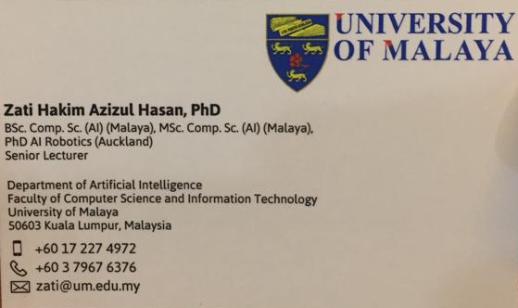
AI Technique: Business card reader
All The Data
Stored in the
Database
Get Scanning

Slide 16
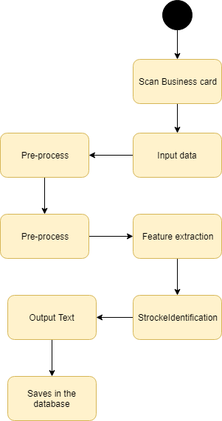
Business card reader
Language : English
Software used : PowerApps, Sharepoint.
accuracy : 90%

Slide 17
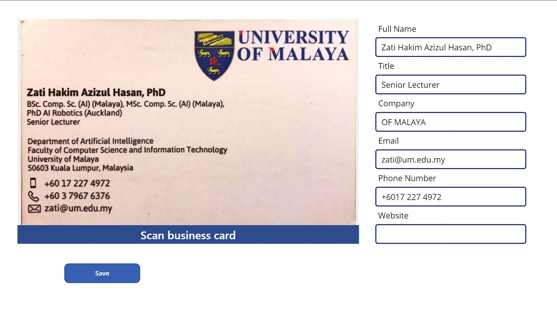
UI2: RPA Business Card Reader

Slide 18
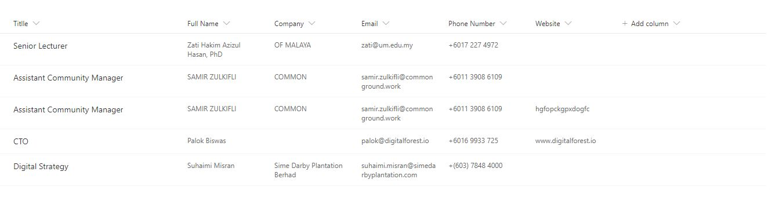
DataBase

Slide 19
THANK YOU Q&A

